Slide 1
CS 4530: Fundamentals of Software Engineering Module 7.1: Software Development Processes
Jon Bell, Adeel Bhutta and Mitch Wand
Khoury College of Computer Sciences
© 2024 Released under the CC BY-SA license

Slide 2
Learning Goals for this Lesson
At the end of this lesson, you should be able to
Know the basic characteristics of the waterfall software process model
Be able to explain when the waterfall model is appropriate and when it is not
Understand how the waterfall and agile models manage risk
Be able to explain how agile process instill quality, including through test driven development
Notes:
<read slide>

Slide 3

Review: How to make sure we are building the right thing
Requirements Analysis
Planning & Design
Implementation
Notes:
In a previous lesson we talked about how requirements analysis is a tough problem, and how gaps in understanding between our team and our client can be problematic. While getting the right requirements can certainly help make sure we build the right thing, it definitely doesn’t guarantee it. This comic also points out the gaps in the actually process of building the software – between the project leader, the designer, and the implementer. How we orchestrate this process, and determine the overall scope of a project is a hard problem.

Slide 4
Software Process: Code + Fix
Build First
Version
Modify until
Customer satisfied
Operations
Retirement
Notes:
This is the baseline approach, which we’ll call “Code and fix”. (Describe the boxes; make the joke that “retirement” might refer to the software, or more likely, the programmer, thanks Mitch ☺ )
What is good about this?
No planning
No expertise
No overhead
Good for “hacking” single use/personal use programs
What is bad about this?
No planning
No way to assess progress ← this is probably the biggest point to make
Difficult to coordinate multiple programmers
What do you think would happen if this was the only way that we built software?
Would the resulting software be:
Delivered on time?
Fully featured?
Performant?
Maintainable?

Slide 5



A brief history of software planning
NATO conference on Software Engineering + Outcomes
Software was very inefficient
Software was of low quality
Software often did not meet requirements
Projects were unmanageable and code difficult to maintain
Software was never delivered
A call to action: We must study how to build software
Notes:
As you probably guessed, this didn’t work so well.
Planning software projects is hard, and in fact, the origin of the term and field software engineering is generally considered to have originated from a 1969 NATO conference, where representatives from member countries described the current “software crisis” - that software was often inefficient, low quality, hard to maintain, and sometimes never delivered. The call to action from this report was to discover methods to build software that were as predictable in quality, cost, and time as, for instance, those used to build bridges in civil engineering.

Slide 6
Software Process: Waterfall (~1970)
Requirements
systematic, sequential approach
Validate
Quality Assurance at each phase before continuing
Design
Verify
Implementation
Test
Operations
Retirement
Notes:
Ah-ha, we can make some general process whereby we build software, just like building a building. Here are some generic process steps.
Discuss each phase, stress that each phase includes some QA step, no need to talk about what’s good or bad yet

Slide 7
Waterfall Model: Risk Assumptions
The cost to fix a defect grows exponentially with each development phase
Notes:
Overall philosophy: "The project is too large and complex, and it will take months (or years!) to plan, so once we come up with the plan, that plan can not change"
assumption: cost to make a change or fix a defect grows exponentially over time - the usual kind of big curve that everyone wants to shift left on.
Nerdy bit: This process draws on classic industrial engineering principles developed by Frederick Taylor; one of the key pieces that everyone needs to understand is that you have a separate QA team that performs QA at each phase of the process

Slide 8
Waterfall Process Improves on Code + Fix
Requirements
Validate
Design
Verify
Implementation
Measurable progress with risk contained in each phase
Possible to estimate each phase based on past projects
Division of labor: Natural segmentation between phases
Test
Operations
Retirement
Notes:
Discuss how waterfall improves over code + fix
Organization
Formal QA process - can conduct QA at each level
Division of labor: senior architects do planning and modeling, junior do construction + QA
Division of labor: might even have some external consultants/auditors who work through your requirements, too
Discussion point: is this division of labor good?
Do we all agree that the senior devs should be doing design, junior the QA?

Slide 9

Waterfall Model adds process overhead
Since formal quality assurance happens at each phase, it’s necessary to produce extremely detailed…
Requirements documents
Design documents
Source code with documentation
Notes:
Emphasize that each phase produces some artifact:
Requirements documents
Design documents
Source code
Waterfall requires *extremely* thorough planning, because you will not proceed to the next step until you are certain that those artifacts are correct. There is no room for interpretation or variance.

Slide 10

Waterfall Model Reduces Risk by Preventing Change
Traditional waterfall model: no way to go back “up”
Notes:
Inflexible partitioning of the project into distinct stages makes it difficult to respond to changing customer requirements.
This big focus on QA of each phase means that even if you wanted to go back to a prior phase (and there are “iterative” versions of the waterfall process, too), you are going to need to throw out a lot of work! What was the point of the extremely thorough requirements documents when you are going to throw them out?
Therefore, this model is only appropriate when the requirements are very well-understood and changes will be very limited during the design process.
But few business systems have stable requirements.

Slide 11
Waterfall Model: Applications
What projects would this work well in?
Projects with tremendous uncertainty
Projects with long time-to-market
Projects that need extensive QA of requirements and design
Projects for which the expense of the planning is worth it
Classic examples: military/defense
Warship that needs to have component interfaces last 80 years
Spacecraft?
Notes:
What if I am the US government, building a naval warship that costs so much money that we expect that it will last at least 80 years?
What will the ship need to do? What will it interface with?
Tremendous uncertainty, but our goal is to draw plans in advance so that we can adapt later when needed
Note: we don’t need every ship in the component to last for 80 years: we are sure to design something with extension points, and upgradable components. But the INTERFACE for those components probably can’t change.
Very much benefits from the “expensive planning up front with external QA teams to review those plans” kind of process
This is not most of our software, though

Slide 12
Waterfall Model: Wasted Work Product
Wasted productivity can occur through each phase’s QA process:
Requirements that become obsolete
Elaborate architectural designs never used
Code that sits around not integrated and tested in production environment, eventually discarded
Documentation produced per requirements, but never read
What if we could eliminate that waste, and reduce the cost of defects later in development cycle?
Example: with shorter time-to-market?

Slide 13
Waterfall Variation: Iterative Process (~1980s)
Initial Concept
Requirements
and Iteration
Planning
Next Iteration
Design and
Implement
Acceptance
Testing
and Delivery
Operations
Notes:
The iterative process takes a waterfall, and it basically just says: “Hey, split up your huge project into smaller projects, deliver each of those projects in one iteration of a waterfall”
Core idea: System requirements ALWAYS evolve in the course of a project so process iteration where earlier stages are reworked is always part of the process for large systems.
User requirements are prioritized and the highest priority requirements are included in early iterations.
Once the development of an iteration is started, the requirements are frozen - but requirements for later iterations can continue to evolve (this is the distinction compared to incremental delivery of feature sets)
There are a variety of pr

Slide 14
The Agile Model Reduces Risk by Embracing Change (~2000)
The Waterfall philosophy:
"The project is too large and complex, and it will take months (or years!) to plan, so once we come up with the plan, that plan can not change"
Reduce risk by proceeding in stages
The Agile philosophy:
The project is too large and complex, it is unlikely that we will know exactly what we need right now, and to some extent, we are inventing something new. We think that as we make it, we will figure it out as we go”
Reduce risk by limiting time on any one stage; then reassess. (“time-boxing”)
Notes:
Throughout the 90’s there were a variety of different software process models proposed to be “more lightweight” than waterfall. We won’t discuss them, other than to say that there were quite a few, and that agile came out on top.
Agile offers the following promise: what if we could build software in such a way that we could embrace both defects and change. If you build a process that can have an “agile” response to shifting requirements, you are also probably building one that can tolerate defects much better.
Compare to waterfall philosophy on risk:
Waterfall says: "The project is too large and complex, and it will take months (or years!) to plan, so once we come up with the plan, that plan can not change"
agile says “The project is too large and complex, it is unlikely that we will know exactly what we need right now, and to some extent, we are inventing something new. We think that as we make it, we will figure it out as we go”

Slide 15
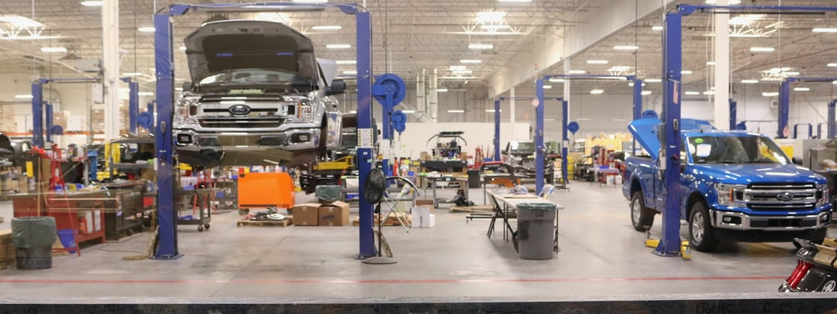
Agile Empowers Workers to Improve Processes: Toyota Production System (1990’s)
Notes:
Toyota production system (TPS)
“Every worker is responsible for the whole production line” – What do you do if you see a defective door go by? If you aren’t the QA inspector you do NOTHING. In TPS, you see that happen and you pull the cord to SHUT IT ALL DOWN AND FIGURE OUT HOW TO DO IT BETTER
Chapter 19 of Kent Beck’s eXtreme Programming eXplained
We think that this is the most important/impactful part of agile. It is easy to say that you are “doing agile” by not planning a lot up front. But: must have a process solution for ensuring quality

Slide 16
Warning: Agile can be a buzzword
Notes:
A lot of different variants of “Agile”

Slide 17
Agile Manifesto
We are uncovering better ways of developing software by doing it and helping others do it. Through this work we have come to value:
That is, while there is value in the items on the right, we value the items on the left more.
Individuals and interactions
Working software
Customer collaboration
Responding to change
over processes and tools
over comprehensive documentation
over contract negotiation
over following a plan
https://agilemanifesto.org
Notes:
The agile manifesto outlines the key principles that underpin agile processes. There are a variety of interpretations of this idea, “software craftsmanship” and “extreme programming” are some.
These values are a direct response to the waterfall processes.
Individuals and interactions – talk about things, localize knowledge vs these big modeling-based approaches. Typically embrace pair programming
Working software – write code that works and is readable, come up with techniques to make it be more likely to be correct.
Respond to change – manage uncertainty by designing and implementing what you need today, don’t make detailed plans in the future
Please note that agile is often talked about as a set of principles and processes that must be obeyed to the letter of the law. We do not claim what is the One True Way™, and many companies will offer certifications in agile this or agile that. Our focus for the next two lessons will be on understanding how agile principles manage risk and improve quality in software development.
If you would like to share this context, it is interesting to point out that the “Agile manifesto” was written and co-signed by 17 white men at a ski resort in Utah. This talk has a nice discussion of this - https://www.youtube.com/watch?v=YL-6RCTywbc

Slide 18
Agile Practice: Everyone is Responsible for Quality
“Collective ownership”
Requirements (user stories) are developed collaboratively with customer, and are negotiable (INVEST qualities)
Functional and non-functional correctness is checked on the cheap, and often
Developers improve code anywhere in the system if they see the opportunity
Many parallels with “Toyota Process System;” a variety of other software processes developed in the 90’s share these basic values
Notes:
Agile also includes a variety of common practices, perhaps the most important being collective ownership.
Contrast this with the waterfall methodology, where quality is checked manually, often taking a lot of time and money. Agile makes quality everyone’s business, and relies upon automated checks of correctness as development goes.
We check functional correctness by running tests (more on that in a minute). Brainstorm: how do we check non-functional requirements?
Code quality checked by linters
Code quality – also pair programming or code review
Performance testing
Acceptance testing: including automated approaches to perform a/b tests and judge user satisfaction

Slide 19
Agile Values Embrace Change
Compare to problems in waterfall:
Requirements that become obsolete
Don’t make detailed requirements until you need them
Elaborate architectural designs never used
Don’t design until you need
Code that sits around not integrated and tested in production environment, eventually discarded
Integrate and test continuously
Documentation produced per requirements, but never read
Don’t require documentation
Or only as much documentation as you really need.
Notes:
Returning to the agile values, we can see how they can respond to problems in the waterfall methodology, and ultimately reduce the cost of uncertainty.

Slide 20

Agile Processes are Iterative
Agile Process Model
Iterative Waterfall Model
Initial Concept
Requirements
and Iteration
Planning
Next Iteration
Design and
Implement
Acceptance
Testing
and Delivery
Operations
Key Idea: Small Continuous Releases
Notes:
Let’s start with a process graphic.
The “process graphic” for agile looks very similar to the iterative waterfall model. Both contain the same phases, pretty much. Both contain a loop. What is different?
Agile has 3d rendering, colors, and round edges.
At its core, agile processes feature the same kinds of activities as the “traditional” processes before it. However, simply saying that you have multiple iterations of your project doesn’t really do anything to reduce the cost of changing requirements or late-detected defects.
The key idea in agile is being able to continuously evaluate the correctness and quality of software. This feeds directly into another key practice of agile processes: small, continuous releases.

Slide 21

Agile Processes Reduce Risk by Time Boxing
Each “iteration” is called a “sprint”
Each sprint has a fixed duration
Scope of features in a sprint is determined by the team
Key insight: planning might be a guess at first, but gets better with time
More on agile planning & estimation in Module 7.2
Notes:
Agile processes reduce risk by setting a time box: each iteration (called a “sprint”) has a fixed duration, typically 2-4 weeks (never more than that).
We say “time box” in contrast to “feature box” - a sprint isn’t defined by what functionality the team wants to deliver: it’s a fixed duration. The date can not change. Only the functionality (scope) can change.
By setting the duration of each sprint to a fixed amount of time, it forces a realistic schedule: it will become apparent quite quickly (after just several sprints) that a schedule is not attainable. How do we know it’s not attainable? Because at the end of the sprint, we find that we can’t finish everything.
We will discuss agile planning in detail in the next lesson. However, we’ll share now that the key insight that makes it work is that time estimation gets better with experience, and agile embraces that growth in experience.

Slide 22
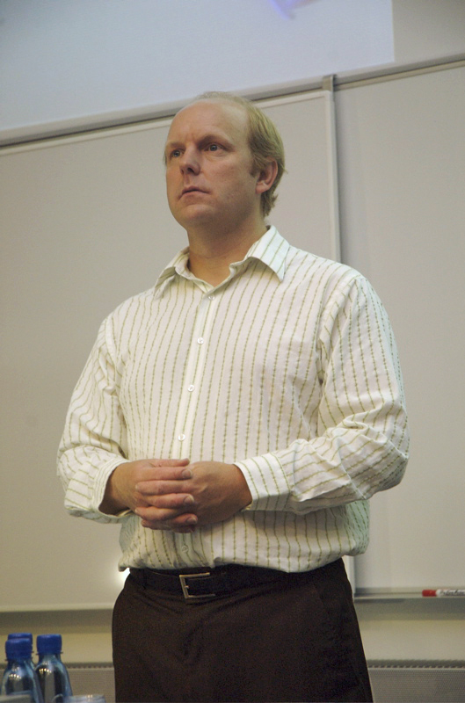
Example Agile Process: XP
"The development of a piece of software changes its own requirements. As soon as the customers see the first release, they learn what they want in the second release...or what they really wanted in the first. And it's valuable learning, because it couldn't have possibly taken place based on speculation. It is learning that can only come from experience. But customers can't get there alone. They need people who can program, not as guides, but as companions."
- Kent Beck, in “eXtreme Programming eXplained”
Notes:
One of the first comprehensive development methodologies that embodied this manifesto is “eXtreme programming”, created by Kent Beck, one of the signatories of the manifesto.
(Let students read quote)
XP is a methodology that aims to take all of the agile principles, and turn them “to the extreme”
You might know Kent Beck for being one of the original authors of Junit. He also pioneered test driven development
He currently works at Facebook.

Slide 23
Agile Practice: Test Driven Development (TDD)
User story & conditions of satisfaction
1. Start here
2. Write a test
Failing Test
5. Strengthen Test
3. Write code
Passing Test
Passing Test, better design
4. Refactor design
Notes:
When Kent Beck was originally working on Agile, he called it "Test first programming" before writing the XP book. But halfway through the book he realized that programming was missing out on much more of what was going on when creating software, and while first is true, it doesn't connect the effect of the testing on the programming - it's not just testing FIRST and then programming, it's using tests to drive your programming. He is one of the biggest promoters of TDD.
Here is a more traditional picture of TDD.

Slide 24
The TDD Cycle (from Module 02)
Analyze
Design
Code
Satisfaction Conditions
Testable Behaviors
Executable Tests
Executing Code
Notes:
Here’s the picture we drew– it’s a little less circular, but otherwise pretty similar.

Slide 25
Agile Practice: Code Review
A code review is the process in which the author of some code is asked to explain it to their peers:
What purpose the code has;
How the code accomplishes this purpose;
How the author is confident of this information,
E.g., show results of running tests (CI results)
A code review often concerns a code change (“diff”)
Notes:
TDD is important in agile, because being able to continuously evaluate the correctness and quality of software is important.
For example, this feeds directly into another key practice to enable agile processes is small, continuous releases.
This provides the ultimate fast feedback loop: are our customers satisfied? What is the impact of each update in production? We can be agile - releasing frequently, in small batches of updates. Thanks to our automated testing infrastructure (hooray TDD), we can be reasonably confident that we won’t break things when we deploy them.
Continuous delivery typically involves multiple stages. For example, the graphic on the right of this slide shows the continuous release platform at Facebook, where each change is released directly once it’s merged into the master branch.
Here’s how it works in the facebook figure: First, the changes go through a series of automated internal tests (again, hooray TDD), once they pass those they are merged into the master branch. Then, it’s pushed to facebook employees, and there are monitoring systems to identify if there are problems; if so there is an “emergency stop” button that prevents the change from moving forward. The scope of a problem is limited to only your employee’s interaction with the app here though, so it’s not a big deal. Then if OK, the change is pushed to 2% of production users, where again there is considerable monitoring. Then, it rolls out to 100% of production, where there are still monitoring systems in place to automatically roll back as needed. Not EVERY change goes straight through, though: as they are building and deploying whole new features, the individual changes that make up those features are kept together, nto deployed until the feature is ready to be released to a set of users.

Slide 26
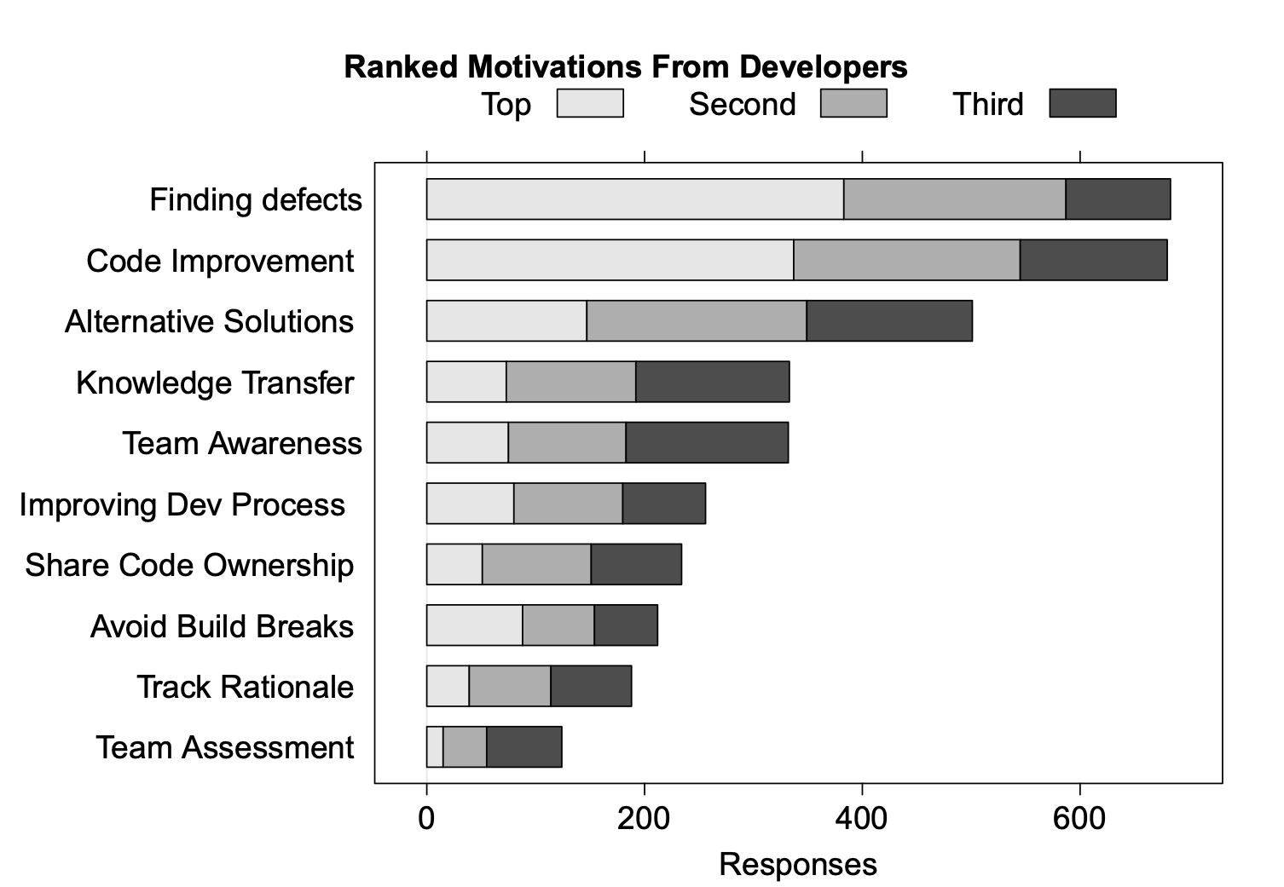
SE Research Question: Why Do Code Review?
“Expectations, Outcomes, and Challenges of Modern Code Review”, Bacchelli & Bird, ICSE 2013
Notes:
This 2013 study conducted internally at Microsoft examined the motivations that developers had for conducting code review.
Code review can check code quality attributes that are hard to automatically check: security, compliance, scalability
From a perspective of our “agile” values, consider particularly the motivations to:
- transfer knowledge
- increase team awareness
- improve processes
- create shared ownership

Slide 27
Learning Goals for this Lesson
At the end of this lesson, you should be able to
Know the basic characteristics of the waterfall software process model
Be able to explain when the waterfall model is appropriate and when it is not
Understand how the waterfall and agile models manage risk
Be able to explain how agile process instill quality, including through test driven development
Notes:
<read slide>

